Slide 1

Search Algorithms
CE2103 - Algorithms and Data Structures II

Slide 2
Disclaimer / Descargo de Responsabilidad
Esta presentación corresponde a una guía usada por el profesor durante las clases. La misma ha sido modificada para ser utilizado en el modelo de cursos asistidos por tecnología. No es una versión final, por lo que la misma podría requerir todavía hacer algunos ajustes. Para aspectos de evaluación esta presentación es solo una guía, por lo que el estudiante debe profundizar con el material de lectura asignado y lo discutido en clases para aspectos de evaluación.
This presentation corresponds to a guide material used by the professor during classes. It has been modified to be used in the model of technology-assisted courses. It is not a final version, so it may still require some adjustments. For evaluation aspects, this presentation is only a guide, so the student should delve with the assigned reading material and what has been discussed in class.

Slide 3
Levels of Complexity
1 | Constant | Common Problems
log N | Logarithmic
N | Linear
N log N | Linear Logarithmic
N^2 | quadratic
N^3 | qubic
2^N | Exponential | Hard Problems
N! | Factorial

Slide 4

Sequential Search
Complexity: O(n)
Is the simplest search algorithm.
Used to search for an element in a list or vector.
In the worst case, as many comparison as elements in the array.

Slide 5
Sequential Search (Code)
Complexity: O(n)
If the array is not sorted
01 02 03 04 05 06 07 | int i = 0; for(; i < N; i++) { if(array[i] == number) break; } if(i == N) i = -1;

Slide 6
Sequential Search (Code)
Complexity: O(n)
If the array is sorted
01 02 03 04 05 06 07 08 09 10 11 | int i = 0; for(; i < N; i++){ if(array[i] == number) break; if(array[i] > number) { i = -1; break; } } if(i == N) i = -1;

Slide 7
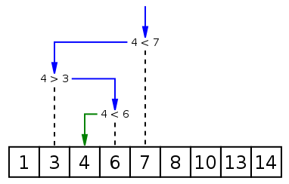
Binary Search
Complexity: O(log (n))
Finds a number in a sorted array.
Compares the input element with the middle of the array.
If the input element matches, return the index to that element.
Otherwise, runs the algorithm with the right or left subarray, depending if the input key is greater or less than the middle element.
Array must be sorted.

Slide 8
Binary Search (Code)
Complexity: O(log (n))
01 02 03 04 05 06 07 08 09 10 11 12 13 14 15 | int binarySearch(int pArray[], int pKey, int pIndexMin, int pIndexMax) { while (pIndexMax >= pIndexMin) { int middle = (int)((pIndexMax + pIndexMin) / 2); if (pArray[middle] < pkey) pIndexMin = middle + 1; else if (pArray[middle] > pKey) pIndexMax = middle - 1; else return middle; } return -1; }

Slide 9
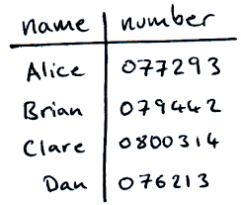
Interpolation Search
Complexity: O(log log (n))
Modification of Binary Search.
In each step tries to calculate where the number might be.
Based on the idea of looking for a person in the phonebook. If you’re looking for Bob, you know it should be at the beginning.

Slide 10
Interpolation Search
Complexity: O(log log (n))
Modification of Binary Search.
In each step tries to calculate where the number might be.
Based on the idea of looking for a person in the phonebook. If you’re looking for Bob, you know it should be at the beginning.
If elements are uniformly distributed, otherwise can be O(n)

Slide 11
Interpolation Search (Code)
Complexity: O(log log (n))
01 02 | middle = low + ((number - array[low]) * (high - low)) / (array[high] - array[low]);
Rest of the code is equal to Binary Search

Slide 12
Interpolation Search (Example)
Complexity: O(log log (n))
01 02 | middle = low + ((number - array[low]) * (high - low)) / (array[high] - array[low]);
5 | 6 | 9 | 11 | 15 | 18 | 20 | 25 | 28 | 39
Let’s search for 28...

Slide 13
Interpolation Search (Example)
Complexity: O(log log (n))
01 02 | middle = low + ((number - array[low]) * (high - low)) / (array[high] - array[low]);
5 | 6 | 9 | 11 | 15 | 18 | 20 | 25 | 28 | 39
The middle will be… 0 + ((28-5) * (10-0)) / (39 - 5) = 6,76 = 7

Slide 14
Interpolation Search (Example)
Complexity: O(log log (n))
01 02 | middle = low + ((number - array[low]) * (high - low)) / (array[high] - array[low]);
5 | 6 | 9 | 11 | 15 | 18 | 20 | 25 | 28 | 39
The middle will be… 0 + ((28-5) * (10-0)) / (39 - 5) = 6,76 = 7

Slide 15
Hashing
f(x)
500000
222151
360951
9948570
19658
500000 9948570
222151 360951
...
...
...
...

Slide 16
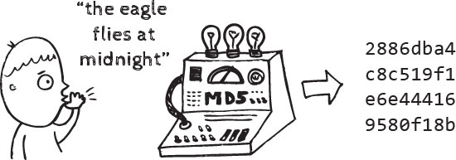
Hashing
CHARACTERISTICS
MORE CHARACTERISTICS
Maps large sets of data to small sets.
It’s a fast search method.
Hash function allows find and assign an index to a key value.
It can map several keys to the same index.
Each slot in the hash table has assigned a set of data. Each slot is called bucket.
Transforms keys to indexes.
The basic hash function for numbers us the identity function. It is not used.

Slide 17
Hashing (Function)
Successive subtraction
f(x)
1998-000
1998-001
1998-002
...
1998-399
1999-000
...
yyyy-nnn
1
2
3
...
399
400
...
N

Slide 18
Hashing (Function)
Successive subtraction
f(x)
1998-000
1998-001
1998-002
...
1998-399
1999-000
...
yyyy-nnn
1998000 - 1998000
1998001 - 1998000
1998002 - 1998000
...
1998399 - 1998000
(1999000 - 1998000) + 399+1
...
yyyynnn - 1998000 + (400 * (yyyy-1998))
0
1
2
...
399
400
...
N

Slide 19
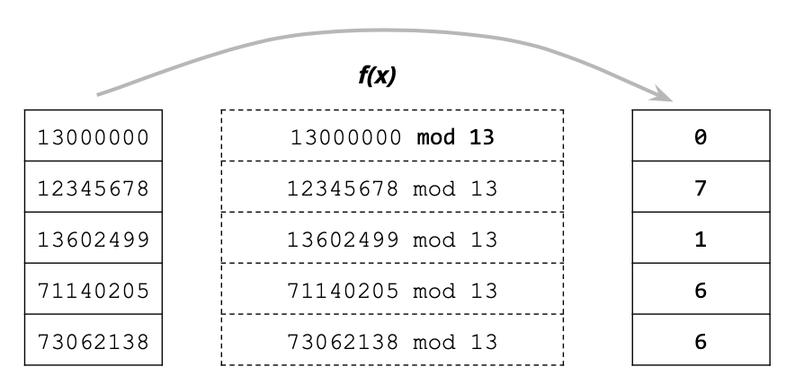
Hashing (Function)
Modular Arithmetic
STRATEGY
EXAMPLE
Use a prime number.
Index is the residue of divide the key between a number (module).
The number defines the amount of buckets of the hash table.

Slide 20
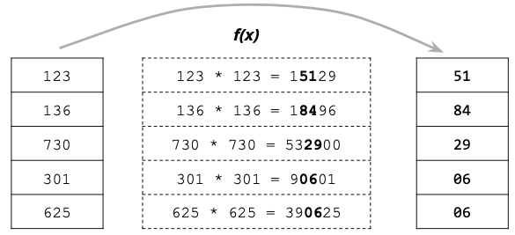
Hashing (Function)
Mid-Square Method
STRATEGY
EXAMPLE
Square the key value.
Takes the middle r digits of the result.
It gives a value between 0 and ( 2^r ) -1

Slide 21
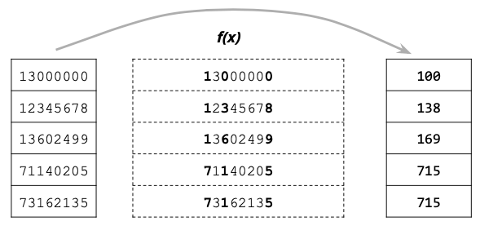
Hashing (Function)
Truncation Method
STRATEGY
EXAMPLE
Ignore part of the key and use the rest as the array index.
You don’t need to get successive numbers.

Slide 22
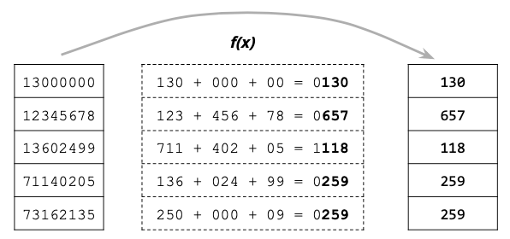
Hashing (Function)
Folding Method
STRATEGY
EXAMPLE
Divide the key in parts.
Combine this parts (might be using operator / * + -).
For example, divide a number of 8 digits in groups of 3 digits and sum this groups.

Slide 23
Hashing (Function)
What’s the problem of Hash Tables?

Slide 24
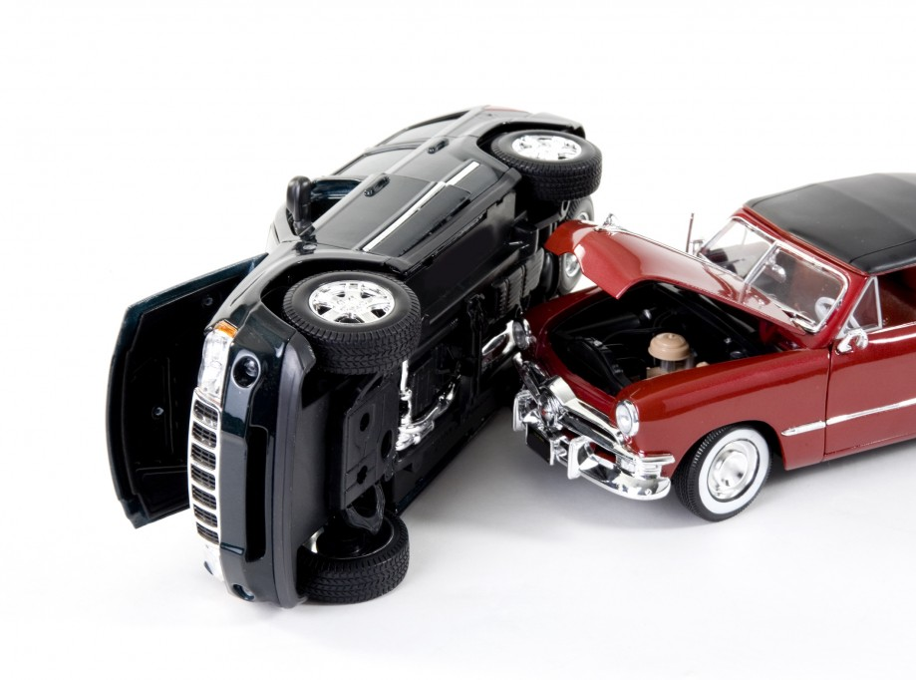
Hashing (Collisions)
Two or more keys with the same index.
Collisions are practically unavoidable. Collisions Treatment in some cases is very expensive.
Wrong choice of hash function can increase this problem.
Almost all the hash slots remaining are empty while a few are full and present a lot of collisions.
Small hash table and too much keys to be
sorted.

Slide 25
Hashing
How to deal with collisions?

Slide 26
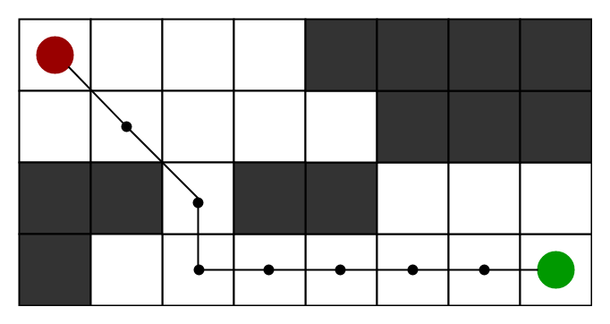
Pathfinding

Slide 27
Pathfinding
CHARACTERISTICS
MORE CHARACTERISTICS
Finds the shortest route between two points.
Used to solve mazes.
We can abstract its functionality by saying its is an algorithm that explore adjacent nodes and selects the closest.
It is usually implemented as an algorithm that runs over a matrix.
Each matrix cell is a node.
These kind of algorithm are used in strategy games.

Slide 28


Pathfinding

Slide 29
Pathfinding (Techniques)
There are many ways to implement Pathfinding.
Depends on the context:
Is the goal moving or stationary?
Are there obstacles?
Is the shortest solution always the best solution?
Is it required to reach a specific destination or just a partial route will do?

Slide 30
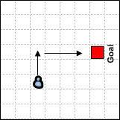
Pathfinding (Techniques)
Simplest Form
STRATEGY
EXAMPLE
There isn’t obstacles. Just compare X and Y axis.

Slide 31
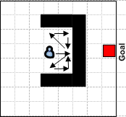
Pathfinding (Techniques)
Random
STRATEGY
EXAMPLE
Take one step at a time in the direction of the goal.
If an obstacle is encountered try to work around it by backstepping a bit in a random direction and then try again.

Slide 32
Pathfinding (Techniques)
Random
STRATEGY
EXAMPLE
Take one step at a time in the direction of the goal.
If an obstacle is encountered takes a random adjacent cell and tries again.
Simplest form with obstacles.
It shouldn’t be used. Algorithm will have a “stupid” behaviour.
Usually, this algorithm does not find the goal. Will get stuck in a multitude of situations.

Slide 33
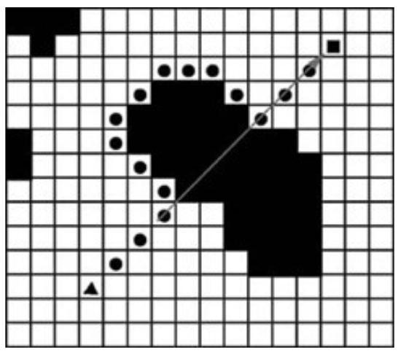
Pathfinding (Techniques)
Obstacle Tracing
STRATEGY
EXAMPLE
Take one step at a time in the direction of the goal.
If an obstacle is encountered start tracing around the object.
Once there’s no obstacle continue moving in the goal’s direction.

Slide 34
Pathfinding (Techniques)
Obstacle Tracing
STRATEGY
EXAMPLE
Take one step at a time in the direction of the goal.
If an obstacle is encountered start tracing around the object.
Once there’s no obstacle continue moving in the goal’s direction.
It can also get stuck in a multitude of situations.

Slide 35
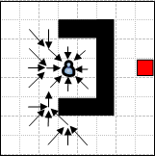
Pathfinding (Techniques)
Breadth-First Search (BFS)
STRATEGY
EXAMPLE
Traverses a tree structure by fanning out to explore the nearest neighbors and then their sublevel neighbors.
From the initial cell, visit the cells at one jump of distance.
If you don’t find the goal, visit at two cells of distance, if you don’t find the goal, visit at three jumps and so on.
It stops when it finds the goal.

Slide 36
Pathfinding (Techniques)
Breadth-First Search (BFS)
STRATEGY
EXAMPLE
Traverses a tree structure by fanning out to explore the nearest neighbors and then their sublevel neighbors.
From the initial cell, visit the cells at one jump of distance.
If you don’t find the goal, visit at two cells of distance, if you don’t find the goal, visit at three jumps and so on.
It stops when it finds the goal.
If there is path to the goal, this algorithm will find it. Maybe no the shortest path.
Inefficient. If the graph is unweighted it funds the shortest path although not too efficiently.

Slide 37
Pathfinding (Techniques)
Depth-First Search (DFS)
STRATEGY
EXAMPLE
Traverses a tree structure by exploring as far as possible down each branch before backtracking.

Slide 38
Pathfinding (Techniques)
In step 1, select this cell and pause exploring the other in the same level.
Depth-First Search (DFS)
STRATEGY
EXAMPLE
Traverses a tree structure by exploring as far as possible down each branch before backtracking.
2
1

Slide 39
Pathfinding (Techniques)
For step 2, select an adjacent cell from the cell selected in step 1.
Depth-First Search (DFS)
STRATEGY
EXAMPLE
Traverses a tree structure by exploring as far as possible down each branch before backtracking.
2
1

Slide 40
Pathfinding (Techniques)
Depth-First Search (DFS)
STRATEGY
EXAMPLE
Traverses a tree structure by exploring as far as possible down each branch before backtracking.
2
1
Can have problems if the depth or the search is not limited.
When using a recursive implementation, may lead to a stack overflow.
It’s better to implement it iteratively using a stack.

Slide 41
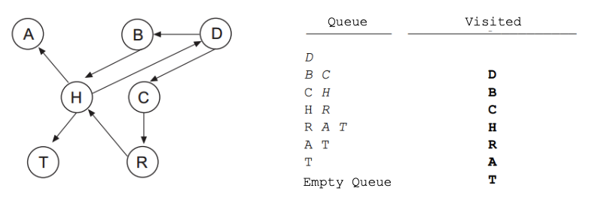
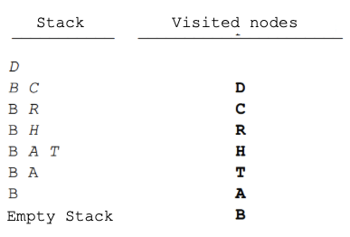
Pathfinding (Techniques)
Difference between BFS and DFS
BFS
DFS

Slide 42
Pathfinding (Techniques)
Dijkstra
STRATEGY
EXAMPLE
Keeps track of the total cost from the start to every node that is visited, and uses it to determine the best order to traverse the grapha.

Slide 43
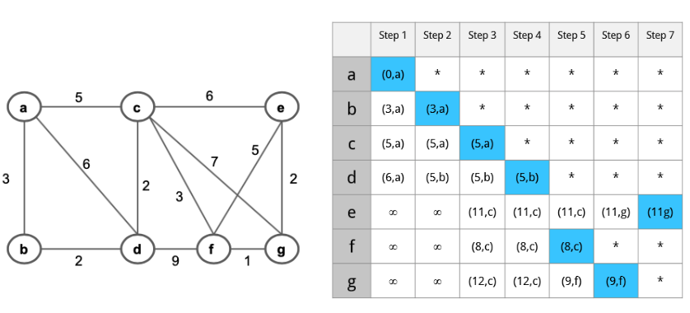
Pathfinding (Techniques)
Dijkstra
STRATEGY
EXAMPLE
Keeps track of the total cost from the start to every node that is visited, and uses it to determine the best order to traverse the graph.
Works with weighted graphs and return the shortest path.
Might involve a lot of searching.

Slide 44
Pathfinding (Techniques)
Best First Search
STRATEGY
EXAMPLE
Similar to BFS but uses an heuristic that chooses the most promising neighbor first.
The path returned may not be the shortest, but it’s faster to run than BFS.
A*

Slide 45
Pathfinding (A*)
STRATEGY
CHARACTERISTICS
Similar to Dijkstra but uses an heuristic that to estimate how likely each node is close to the goal, in order to make the best decision.
Precise.
Efficient and Fast. Finds the shortest path in a weighted graph processing fewer cells and taking less time to perform the calculation.
Maybe doesn’t find the optimal path, but will find a close option.
One of the most commonly used in games programming. It’s extremely configurable to the particular type of game and map.

Slide 46
Pathfinding (A*)
Search area

Slide 47
Pathfinding (A*)
Search area
Divide the area into a square grid. You can divide the area in another kind of shape.
Center point in each square is called node.
Each cell has a state

Slide 48
Pathfinding (A*)
Wall or obstacles
Search area

Slide 49
Pathfinding (A*)
Goal
Search area

Slide 50
Pathfinding (A*)
Search area
Starting point

Slide 51
Pathfinding (A*)
Algorithm
Add the starting point to an open-list of elements.
Check the adjacent walkable squares, add the squares to the open-list, save the starting point as a parent of these squares.
Remove the starting point from the open-list and add it to the close-list.
Get one of the adjacent squares in the open-list and repeat the process.

Slide 52
Pathfinding (A*)
Path Scoring
F = G + H
G = movement cost to move from the starting point to a given square on the grid.
H = estimated cost to move from a given square on the grid to the final destination (heuristic).

Slide 53
Pathfinding (A*)
You have to choose the cell with the lowest F score.
You have to assign a cost to move horizontal, vertical and diagonal.
Path Scoring
F = G + H
G = movement cost to move from the starting point to a given square on the grid.
H = estimated cost to move from a given square on the grid to the final destination (heuristic).

Slide 54
Pathfinding (A*)
How to calculate H
Variety of methods, there isn’t a well known solution. For Example:
EUCLIDEAN DISTANCE
MANHATTAN DISTANCE
dx = targetX - currentX;
dy = targetY - currentY;
h = sqrt((dx * dx) + (dy * dy));
dx = abs(targetX - currentX);
dy = abs(targetY - currentY);
h = dx + dy;

Slide 55
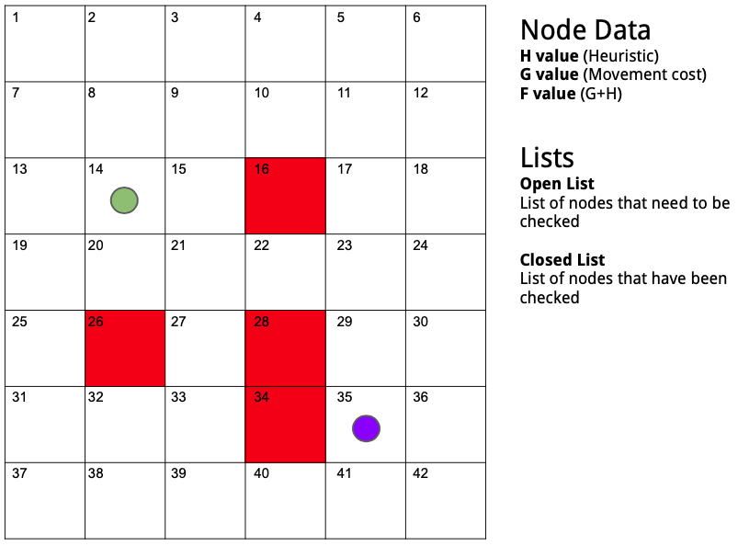
Pathfinding (A*)

Slide 56
Pathfinding (A*)
This is the game area

Slide 57
Pathfinding (A*)
Red cells are walls / buildings / obstacles

Slide 58
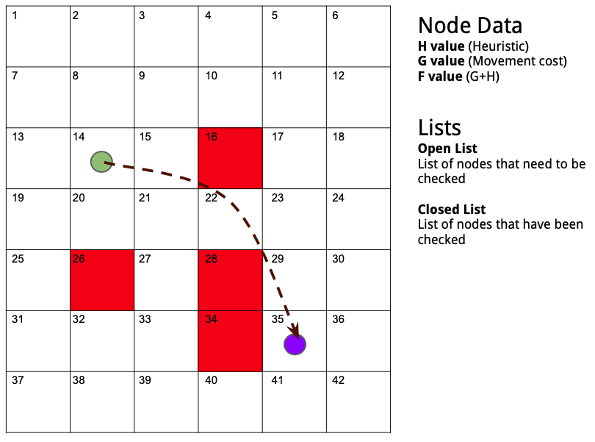
Pathfinding (A*)
We need to find the path from green point to blue with the shortest path

Slide 59
Pathfinding (A*)
Each block is called “node”

Slide 60
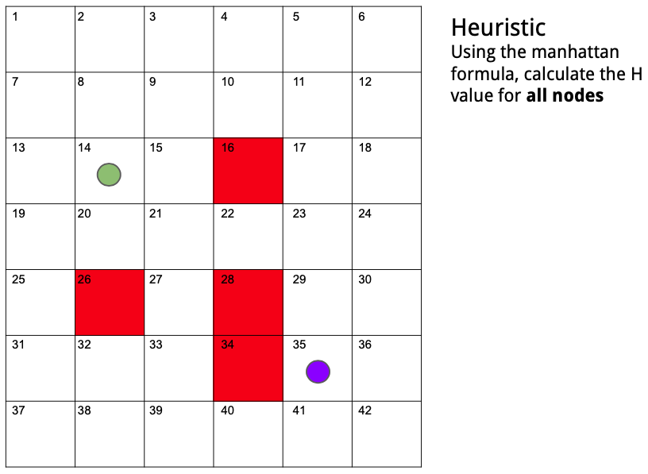
Pathfinding (A*)

Slide 61
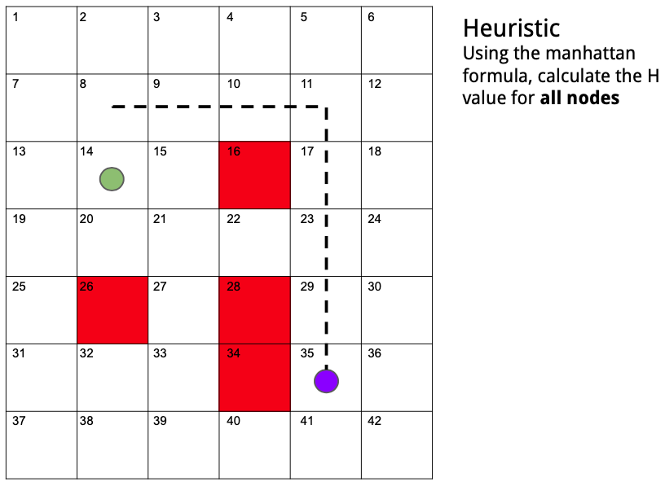
Pathfinding (A*)

Slide 62
Pathfinding (A*)
This node has a H value of 7

Slide 63
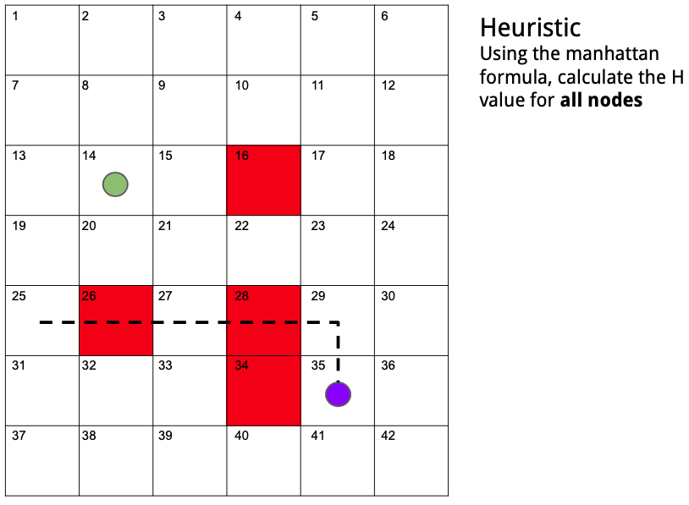
Pathfinding (A*)
This node has a H value of 5

Slide 64

Pathfinding (A*)

Slide 65
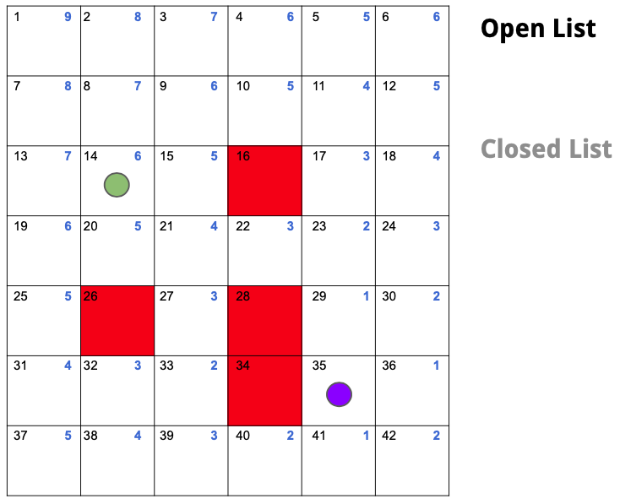
Pathfinding (A*)

Slide 66
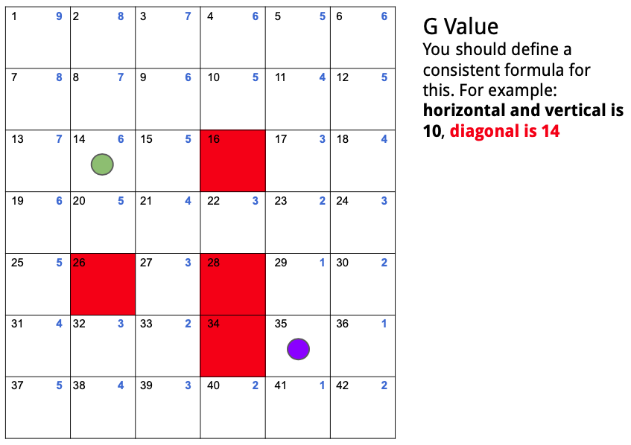
Pathfinding (A*)
Each node has parents

Slide 67
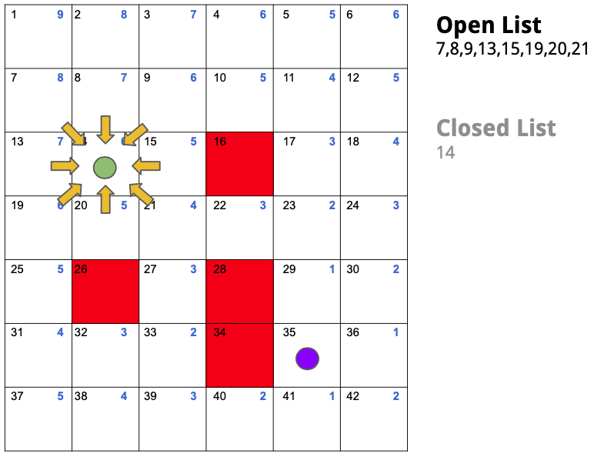
Pathfinding (A*)

Slide 68

Pathfinding (A*)
This node is parent of 7, 8… so on

Slide 69
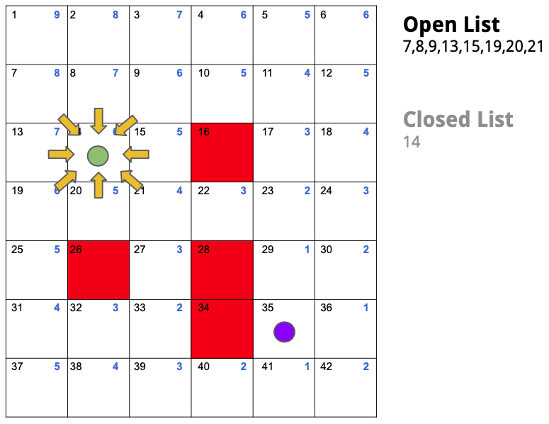
Pathfinding (A*)
Now, calculate G

Slide 70

Pathfinding (A*)

Slide 71

Pathfinding (A*)

Slide 72
Pathfinding (A*)
Now select the smallest F value

Slide 73
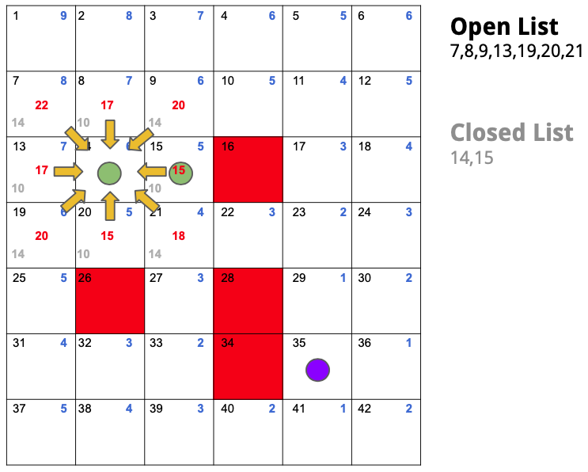
Pathfinding (A*)

Slide 74
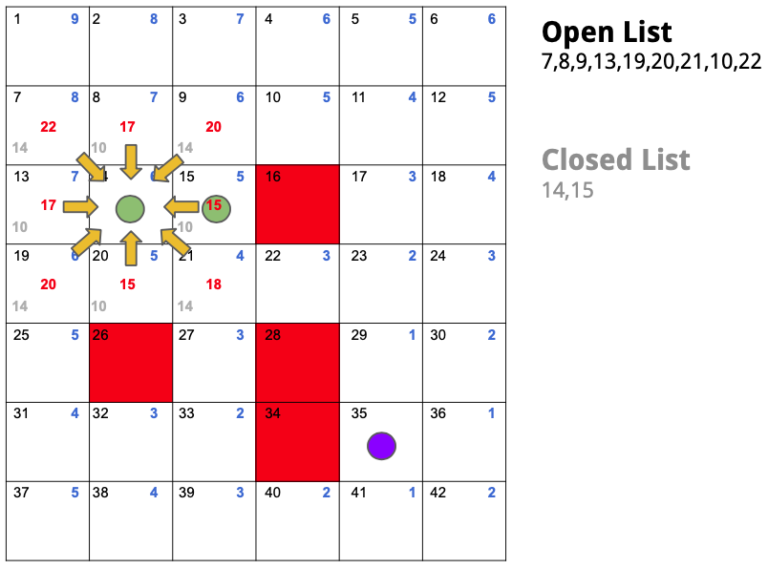
Pathfinding (A*)

Slide 75

Pathfinding (A*)
Re-parent nodes...

Slide 76
Pathfinding (A*)
G value for node 15 is 15. G value for node 9 is 20.
15 + 10 > 20
So no re-parent is done for node 9

Slide 77

Pathfinding (A*)

Slide 78
Pathfinding (A*)
Repeat process...

Slide 79
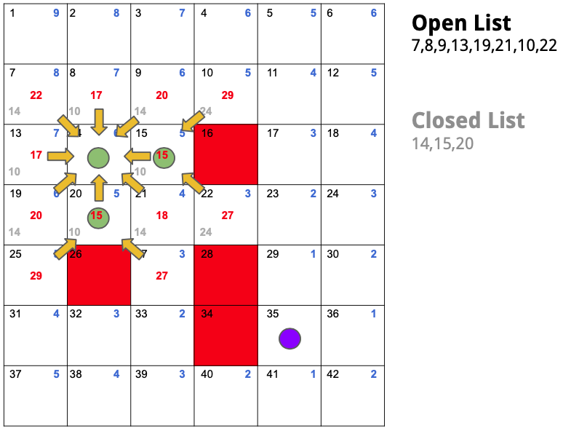
Pathfinding (A*)

Slide 80
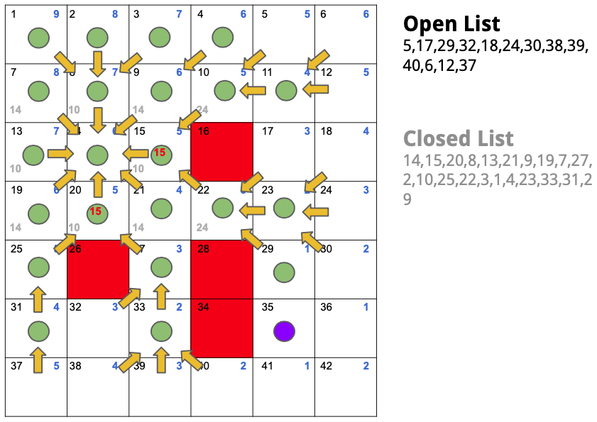
Pathfinding (A*)

Slide 81
Pathfinding (A*)
Stop! We are at only one position from the goal

Slide 82
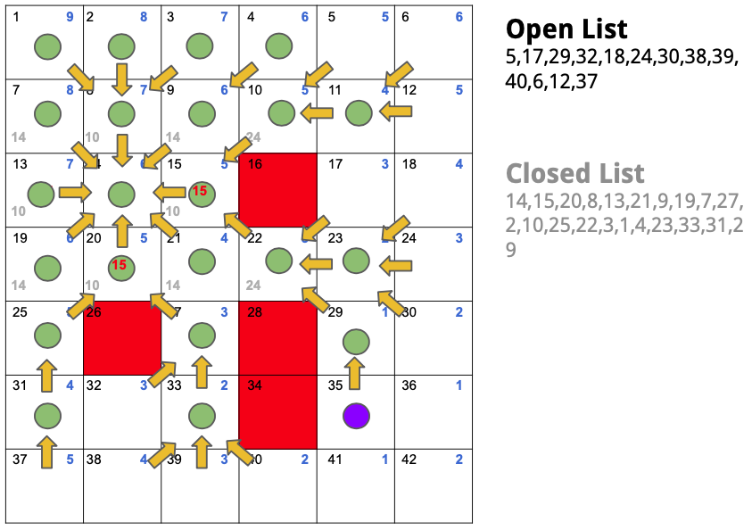
Pathfinding (A*)

Slide 83
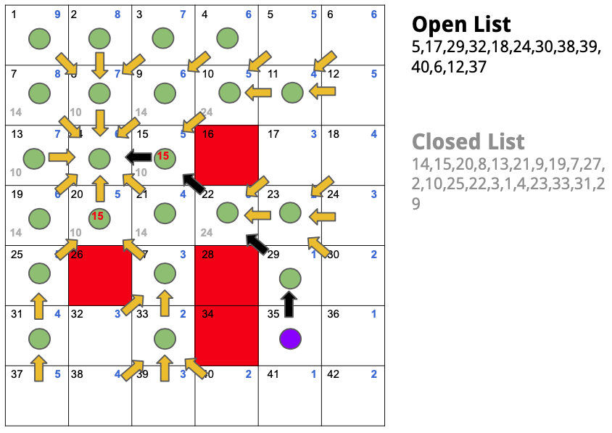
Pathfinding (A*)

Slide 84
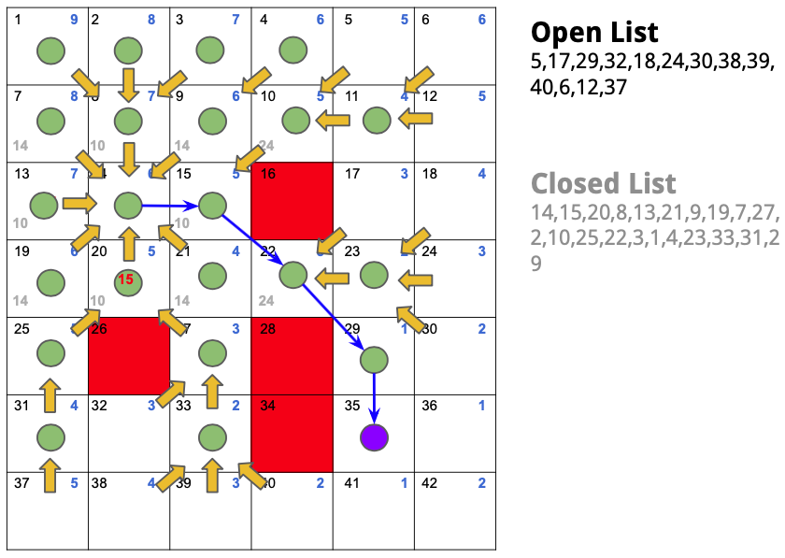
Pathfinding (A*)

Slide 85
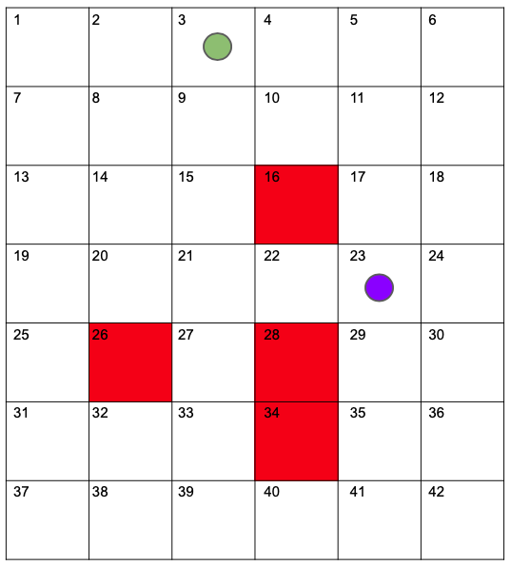
Pathfinding (A*)

Slide 86
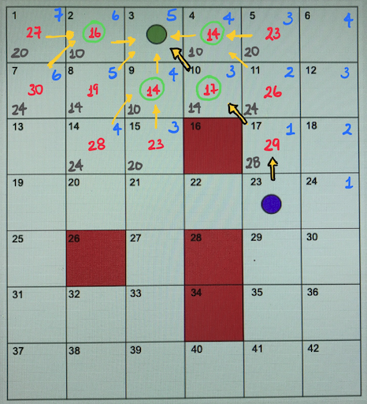
Pathfinding (A*)

Slide 87
Pathfinding (A*)
There are variations of A* that make it faster or more adapted to certain circumstances:
LPA*. Similar to A* but can more quickly recalculate the best path when a small change to the graph is made
D* Lite. Based on LPA*, it does the same thing, but assumes the "start point" is a unit moving towards the finish while graph changes are being made
HPA* (Hierarchical). Uses several layers at different abstraction levels to speed up the search. For instance, an higher level layer may simply connect rooms, while a lower level layer takes care of avoiding obstacles.
IDA* (Iterative Deepening). Reduces memory usage in comparison with regular A* by using iterative deepening.
SMA* (Simplified Memory-Bounded). Only makes use of available memory to carry out the search.
Jump Point Search. Speeds up pathfinding on uniform-cost grid maps.

Slide 88
Search Algorithms
CE2103 - Algorithms and Data Structures II

Slide 89
Let's practice!

